Slide 1
Week 10:
Entities
W266
Natural Language Processing

Slide 2
Peeking ahead...
Week 1- 2: NN Basics & Training
Week 3: Classification & Sentiment
Week 4: Part of Speech + Parsing
Week 5: Convolutional Neural Networks (CNNs)
Week 6 - 7: Language Models
Week 8: Machine Translation
Week 9: Advanced MT: Transformers & Transfer Learning
Week 10: Entities/Information Extraction
Week 11: Summarization and a touch of question answering
Week 12: Document Classification
Week 13: Information Retrieval

Slide 3
Session Overview...
Announcements
Project Check in
Last Week
Information Extraction and Grounding
Named Entity Recognition
Entity Resolution
Entity Linking / Coreference Resolution
Relation Extraction

Slide 4
Announcements
Final Assignment 7 released 03/06
Due date: Sunday 03/14 at 11:59 pm PST.
Projects
Due Saturday 04/10 11:59 pm PST (hard deadline!)
~ 4 to 5 weeks
Your presentations in class 04/12-04/17.
Questions?
Concerns?

Slide 5
Project check-In
Who has their data? (hopefully, everybody)
Who has a baseline? (most groups?)
Experiments to improve baseline?
Analysis?
Problems?
If you want to turn in an optional draft of your paper you’ll need to get it to the instructors by 03/13. We’ll review and get back to you either via email or in office hours the following week.

Slide 6
Announcements (continued)
Paper reading sessions:
Universal Text Representation from BERT: An Empirical Study
Joachim: Thursday, 03/11, Noon PST
Exploiting Cloze Questions for Few Shot Text Classification and Natural Language Inference
Joachim: Thursday, 03/18, Noon PST
Notebook walkthroughs:
NLP Application: Name Matching/Deduplication
Gurdit: Friday, 03/12, 1:00 pm PST

Slide 7
Key Learnings Review

Slide 8
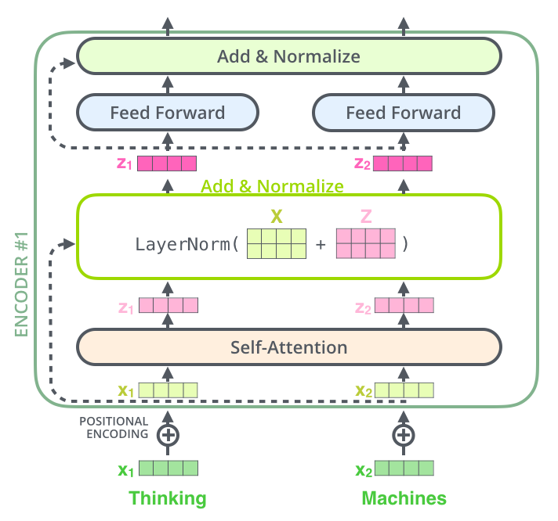
Last Week: The Transformer Architecture
Image Source & excellent blog: http://jalammar.github.io/illustrated-transformer /
Notes:
More Transformer Architecture (appendix)

Slide 9
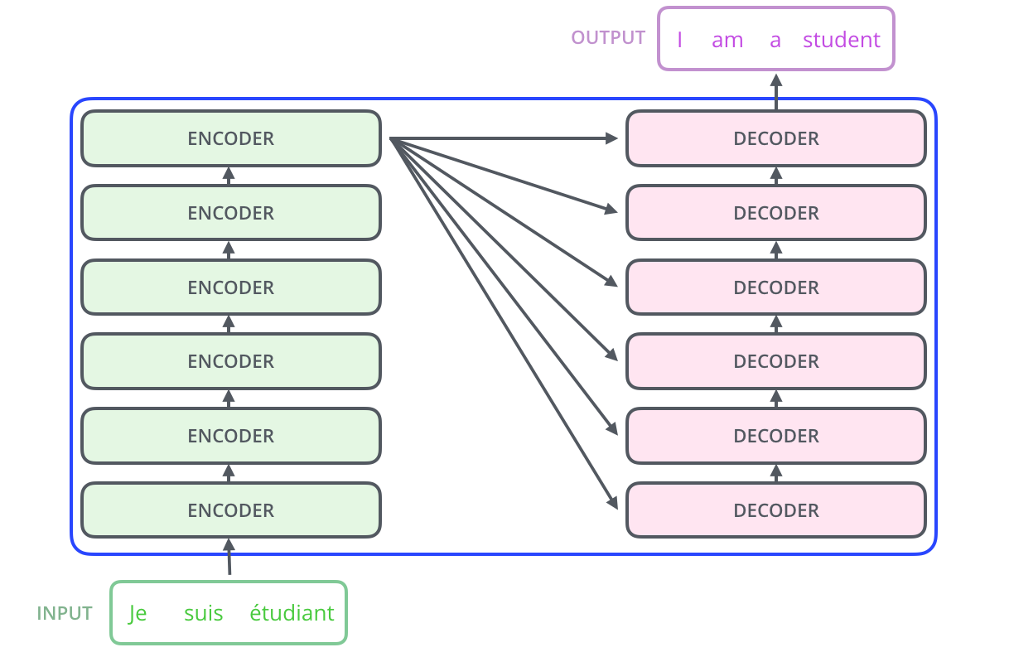
Last Week: The Transformer Architecture
Image Source: jalammer.github.io/illustrated-bert

Slide 10
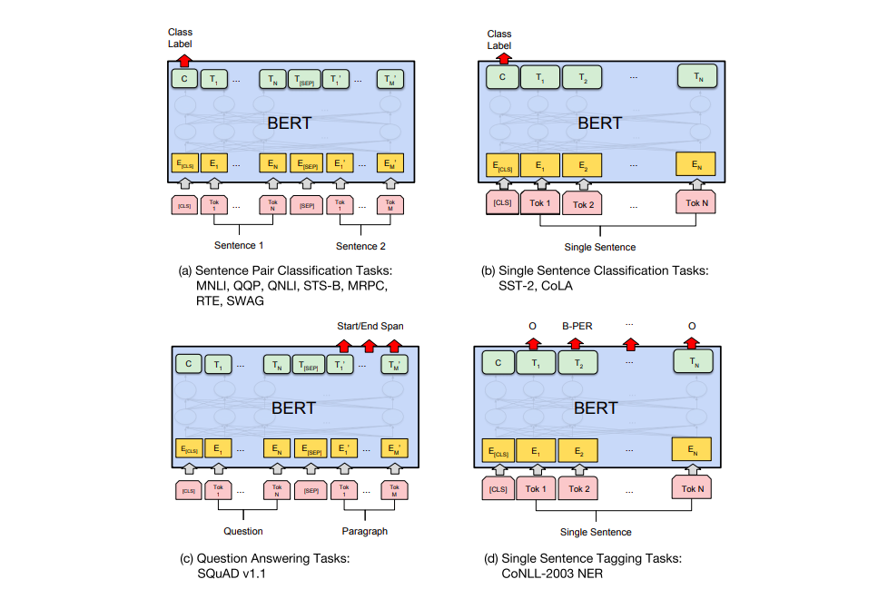
BERT Fine-Tuning Tasks
Image Source: jalammer.github.io/illustrated-bert

Slide 11
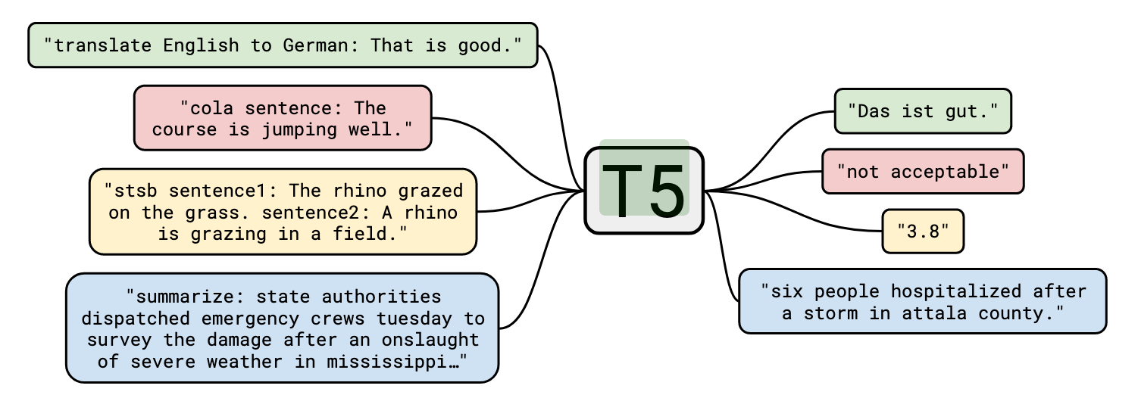
T5 Structure
Pre-trained Encoder + Decoder transformer architecture
Pre-trained on multiple tasks:
Pre-trained on Colossal Clean Crawl Corpus’ with generic task
Fine-tuned on various GLUE/SuperGLUE tasks
Available Sizes (at HuggingFace)
Small
Base
Large
3GB
11GB
+ MANY customized fine-tuned models (https://huggingface.co/models)
Source: ”Exploring the Limits of Transfer Learning with a Unified Text-to-Text Transformer”, Raffel et al, https://arxiv.org/pdf/1910.10683.pdf

Slide 12
Information Extraction

Slide 13
Information Extraction
An umbrella term encompassing multiple tasks:
Identify named entities in text and all references to entities
Named Entity Recognition and Mention Detection
Cluster references to the same entity
Coreference Resolution
Disambiguate mentions and link to real world counterparts
Entity Linking
Identify relations between entities in text
Relation Extraction

Slide 14
Information Extraction vs. Retrieval
Information Retrieval (IR) - search engine
Goal: satisfy “information need” from query
How: retrieve specific information from corpus
Usually unstructured - string/keyword matching
Information Extraction (IE) - knowledge base
Goal: discover/extract structured information
How: mine lots of information from corpus
Structured information via ML or patterns
(often) Grounded entities
Notes:
We’ll cover information retrieval in week 13

Slide 15
Grounding
So far in the course, low-level NLP: everything ungrounded
Recall Week 1: manipulate text, but no idea what it means
Information Extraction starts (partly) to resolve this
Deal with entities. Can ground to “real world.”
Entity recognition: identify entities (“NER”)
Resolution: ground identified entities
Coreference: recognize things that refer to entities
Relation extraction: describe entities

Slide 16
Caveats / Limitations of IE
IE != full semantic understanding
Only try to understand parts of language: entities and their surroundings and specific relationships between the entities.
Ex: building a knowledge base - OK to have low per-sentence recall
Can extend further:
Semantic Role Labeling (predicate-argument relations)
Semantic Parsing (build on entity recognition + SRL)
Multi-modal models (text + images)
Grounding of “concepts” (e.g. “red” = , “cat” = 🐱)

Slide 17
Named Entity Recognition (NER)

Slide 18
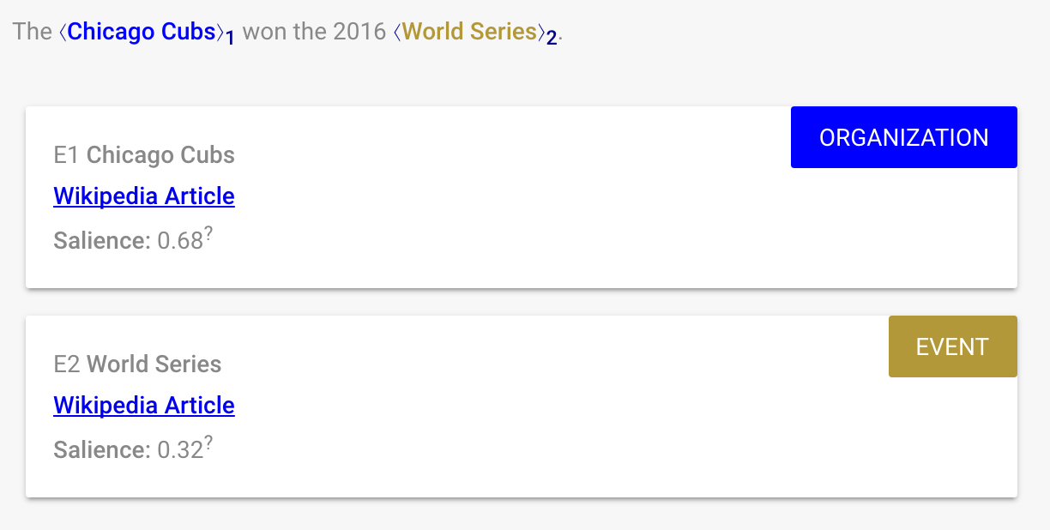
Named Entity Recognition
Base-level IE task. Find things, assign them a type.

Slide 19
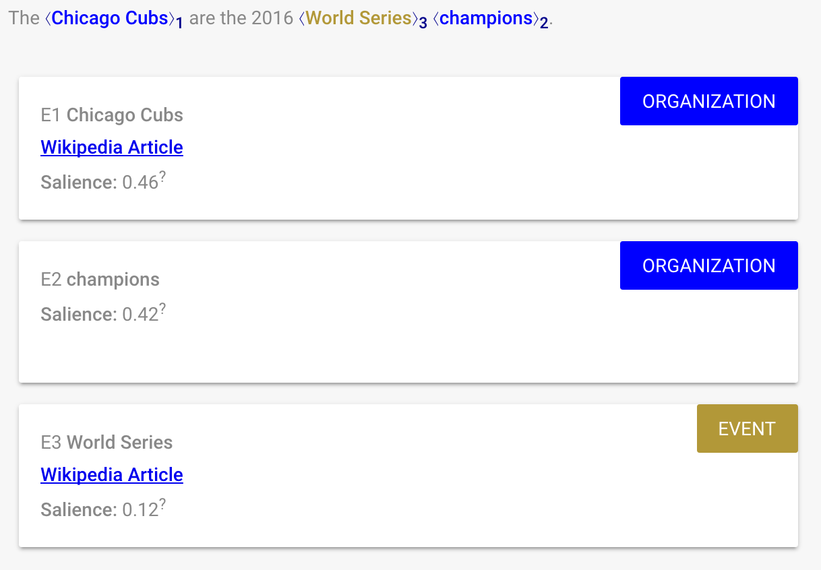
Notes:
Anyone guess what’s happening here? (why is “champions” an organization?)

Slide 20
How to predict?
Sequence tagging task: for each word, assign {PER, GPE, MISC}
Need BIO encoding to signal endpoints
assign {PER, CITY, STATE, MISC}
O | O | B-GPE | I-GPE | B-GPE
train | fares | New | York | Boston
O | O | B-CITY | B-STATE
train | fares | Boston | Massachusetts
Notes:
Classic tagset from CoNLL 2003 shared task: https://www.clips.uantwerpen.be/conll2003/ner/ , although in practical applications you might want something with finer-grained types.

Slide 21
Examples
Sid Reddy lives in New York and Rob stays in Seattle.
B-PER, I-PER, O, O, B-LOC, I-LOC, ...
Sid->B-PER Reddy->I-PER lives->O in->O New->B-LOC York->I-LOC and->O Rob->B-PER stays->O in->O Seattle->B-LOC .->O
Her Majesty’s Theatre is in London England and Madison Square Garden is in New York New York.

Slide 22
How to predict labels?
Which architectures and task structures can we use to predict labels?

Slide 23
How to predict labels?
Standard sequence-labeling models
Brainstorm: features?
Bi-RNN
Notes:
Modern models combine aspects of several of these; common to have biRNN encoder layers and CRF output, or use another decoding scheme such as A* search or a semi-Markov model to predict spans directly.

Slide 24
How to predict labels?
Standard sequence-labeling models
Brainstorm: features?
Window model / CNN
Bi-RNN
Notes:
Modern models combine aspects of several of these; common to have biRNN encoder layers and CRF output, or use another decoding scheme such as A* search or a semi-Markov model to predict spans directly.

Slide 25
How to predict labels?
Standard sequence-labeling models
Brainstorm: features?
Window model / CNN
Bi-RNN
Conditional random field (CRF)
Notes:
Modern models combine aspects of several of these; common to have biRNN encoder layers and CRF output, or use another decoding scheme such as A* search or a semi-Markov model to predict spans directly.

Slide 26
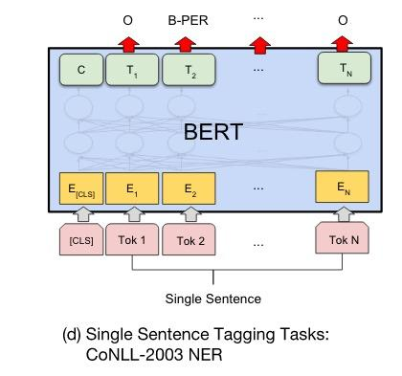
How to predict labels?

Slide 27
Neural Architectures for Named Entity Recognition
BERT: Pre-training of Deep Bidirectional Transformers for Language Understanding
Paper Peeks
Notes:
BiLSTM with CRF layer - using both pre-trained word and learned character embeddings.
BERT embeddings provide a marked boost in performance on NER task without a CRF.

Slide 28
Entity Resolution

Slide 29
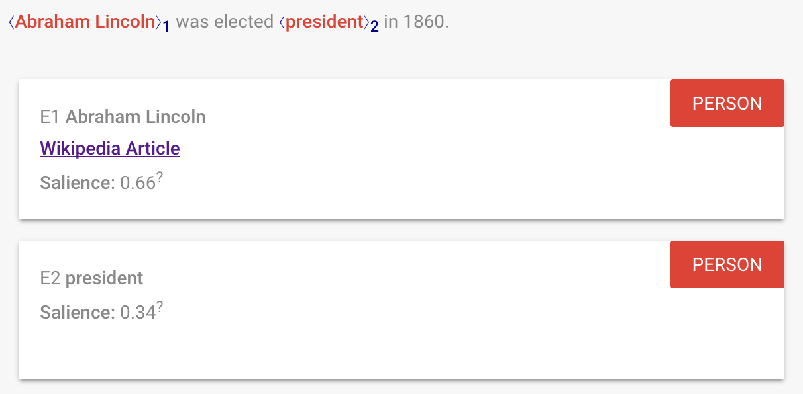
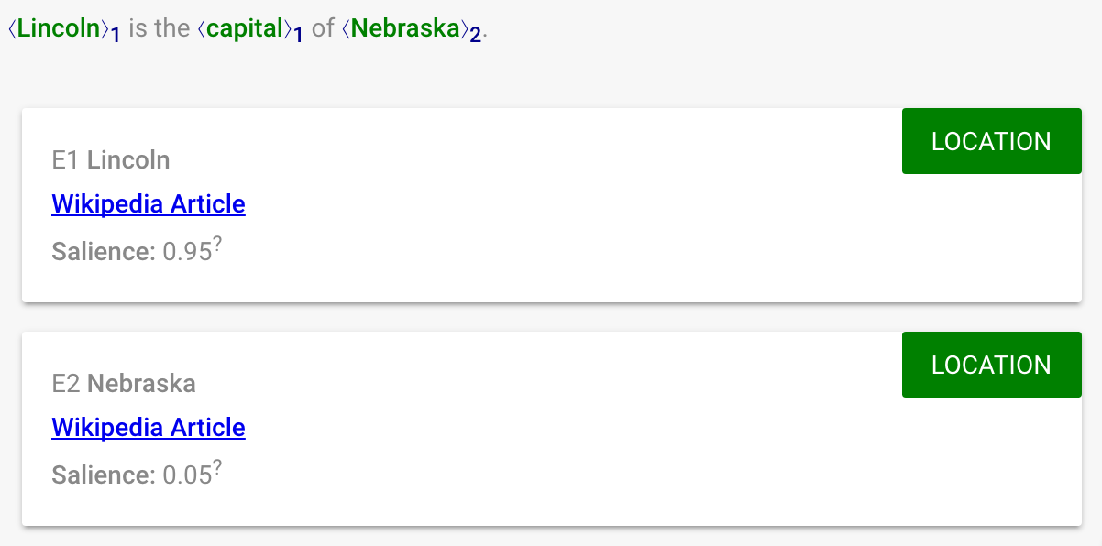
(partial) Sense Disambiguation/Resolution
Lincoln (person)
Lincoln (place)
POS tagging, parsing: resolve (some) syntactic ambiguity
NER tagging: resolve (some) semantic ambiguity
Notes:
As with most NLP tasks, NER requires resolving (some) ambiguity. Semantic ambiguity somewhat orthogonal to the syntactic ambiguity we saw before.

Slide 30
Temporal Resolution Example
You’ve found all the time and date mentions in the text. What is “now”?
Convert date and time mentions in text to canonical representation.
Complex annotation schemes to allow inference:
Timex3/TimeML
SCATE (Semantically Compositional Annotation of Time Expressions)
NEWS STORY
10/20/2000 20:02:07.85 The Navy has changed its account of the attack on the USS Cole in Yemen. Officials now say the ship was hit nearly two hours after it had docked.
From Characters to Time Intervals: New Paradigms for Evaluation and Neural Parsing of Time Normalizations

Slide 31
Temporal Resolution Example
You’ve found all the time and date mentions in the text. What is “now”?
Convert date and time mentions in text to canonical representation.
Complex annotation schemes to allow inference:
Timex3/TimeML
SCATE (Semantically Compositional Annotation of Time Expressions)
NEWS STORY <TIMEX3 tid="t0" type="TIME" value="2000-10-20T20:02:07.85">10/20/2000 20:02:07.85</TIMEX3> The Navy has changed its account of the attack on the USS Cole in Yemen. Officials <TIMEX3 tid="t1" type="DATE" value="PRESENT_REF" temporalFunction="true" anchorTimeID="t0">now</TIMEX3> say the ship was hit <TIMEX3 tid="t2" type="DURATION" value="PT2H">nearly two hours after </TIMEX3> it had docked. <TLINK timeID="t2" relatedToTime="t0" relType="BEFORE"/>
From Characters to Time Intervals: New Paradigms for Evaluation and Neural Parsing of Time Normalizations

Slide 32
Entity Linking / Coreference Resolution

Slide 33
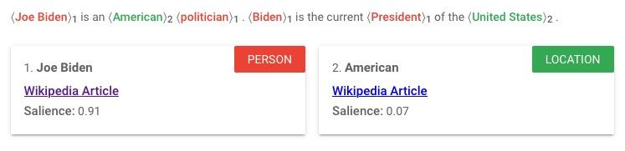
Entity Linking
Goal: resolve different mentions of the same entity and link to DB entry
Mention: a single “chunk” (an instance of a word-symbol)
Entity: a grounded “thing” (the concept-thing)
Brainstorm: features?

Slide 34
Coreference Resolution
Cluster all mentions of an entity in text
Hard cases require nuanced semantic understanding
Ex: Winograd schema
“The city councilmen refused the demonstrators a permit because they advocated violence.”
“The city councilmen refused the demonstrators a permit because they feared violence.”
Notes:
See https://en.wikipedia.org/wiki/Winograd_Schema_Challenge

Slide 35
Coreference Resolution
Linguistics note: “anaphora resolution”
Anaphora: expression depends on antecedent
“Sally arrived, but nobody saw her”
Cataphora: expression depends in postcedent
“Before her arrival, nobody saw Sally”
Other types of referents:
Exophora: external context (maybe unresolved)
“He was standing over there”

Slide 36
Machine learning or heuristics?
One very popular heuristic for pronoun coreference resolution is called Hobbs.
Start at pronoun and search parse tree: Left -> Right within sentence Right -> Left within sentence
Right -> Left across sentences Stop when you find a matching noun phrase.
Can use as a ML feature!

Slide 37
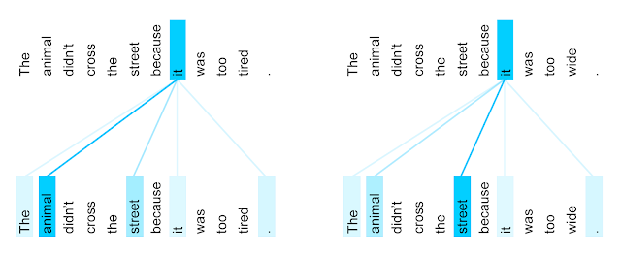
Remember: Attention is All You Need
Winograd schema: coreference examples
Notes:
More Transformer Architecture (appendix)

Slide 38
Brainstorming: Beyond Heuristics
Example: “General Electric said the Postal Service contacted the company to... ”
Discussion: What does ‘company’ refer to? How could this be approached? (Assume no parse tree, POS/NER tokens...)
...
…
...

Slide 39
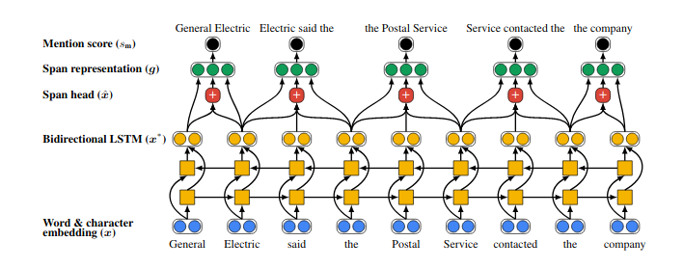
Neural (Pre-BERT) Coreference Resolution
No hand coded features with two processing stages:
Stage 1 of 2
Identify spans
Score potential entity mentions
Prune low scoring candidates
From: End-to-end Neural Coreference Resolution

Slide 40
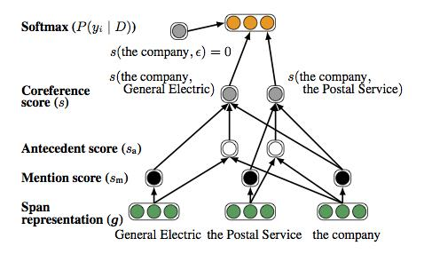
Neural Coreference Resolution
No hand coded features
Stage 2 of 2
Score pairs of spans
From: End-to-end Neural Coreference Resolution

Slide 41
Neural Coreference Resolution with BERT
Replace bi-LSTMs with BERT
Use BERT to generate span representations within independent segments of documents
Concatenate BERT embedding for first and last word piece in span
Combine with iteratively recomputed attention vector for span “head” based on antecedent distribution
Calculate score for each mention (span) and probability that two spans refer to same entity
Discussion: BERT for spans? Yes… sure. Works ok. But does BERT know anything about spans? Can we maybe improve?
Antecedent distribution introduced by Lee et al. (2018) Updated bi-LSTMs with BERT in Joshi et al., 2019
Notes:
Better improvement for BERT-large vs BERT-base

Slide 42
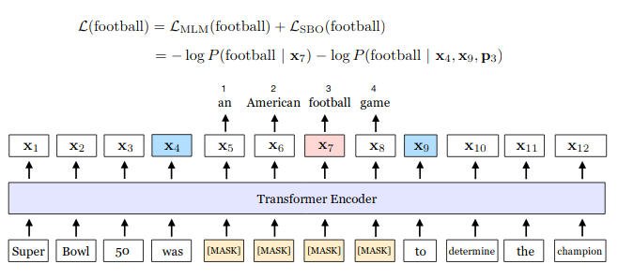
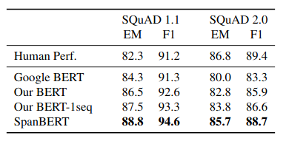
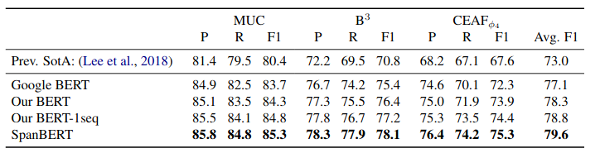
Even Better: SpanBERT
Targeted BERT-like model pre-trained for span-type problems
SpanBERT Training
Insight: mask spans and add span-related training objectives!
SpanBERT Results for SQuad and Co-ref Benchmarks
Source: SpanBERT in Joshi et. al., 2020

Slide 43
Relation Extraction

Slide 44
Relation Extraction
Binary relation: relational triple (e_1, relation, e_2)
(Geoffrey Hinton, place-of-birth, Wimbledon)
(Geoffrey Hinton, date-of-birth, 1947-12-06)
Many relations are not binary:
“<company> appointed <person> as <position>”
But often can decompose:
(<person>, employed-by, <company>)
(<person>, has-job-title, <position>)
(<company>, uses-job-title, <position>)

Slide 45
Knowledge Bases
WordNet: low-level semantic relations
Hypernymy: (Giraffe, hyponym-of, animal)
Meronymy: (leg, part-of, chair)
Freebase / Google Knowledge Graph: world knowledge
(Fight Club, /film/film/starring, Brad Pitt)
(Joe Biden, /people/person/date_of_birth, 1942-11-20)
Notes:
https://www.google.com/search?sxsrf=ALeKk035C3K6T1kZs1plIGTe4SRKs7wIEQ%3A1615163737401&ei=WXFFYMSAGLOs0PEPruu5kAs&q=when+was+joe+biden+born&oq=when+was+joe+biden+born

Slide 46
How to extract relations?
Basic task:
Find mentions of entities
Extract relations from mention context
“<Joe Biden> is the <President> of the <United States>.”
(Joseph Biden, head-of-state, United States)
Problem Formulations:
Rule-based (e.g. Hearst patterns)
Supervised (extract & score)
Semi-supervised (bootstrapping)
Unsupervised (clustering of patterns )
See also: Building Dynamic Knowledge Graphs From Text Using Machine Reading Comprehension

Slide 47
Hearst Patterns
Corpus driven expansion of a handful of hand-written patterns,
“...X, such as the Y”
“Y, Y, and/or other X”
“X, including Y, Y … and Y”
“X especially Y and/or Y”
Brainstorm: what are we missing?

Slide 48
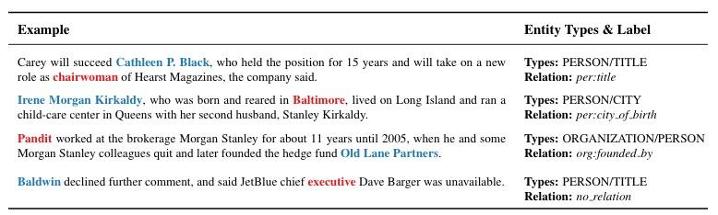
Supervised Relation Extraction
TACRED - large dataset of sentences labelled with Subject and Object and 42 typed relations including no_relation
spanBERT - “[CLS] [SUBJ-PER] was born in [OBJ-LOC], Michigan, . . . “
Classifier on top of CLS token produces near SOTA 70.8 F1 score

Slide 49
Bootstrapping and Narrative Frames
Relations don’t exist in isolation. Common clusters of co-occurring relations form frames and scripts which we can use to fill in gaps.
Example: “The concert is tomorrow. We’re going see Travis Scott.”
Explicit Relations: (concert, when, tomorrow) (we, will-see, Travis Scott)
Implicit Relations: (we, will-go, concert) (Travis Scott, is-a, musician)

Slide 50
Unsupervised Relation Extraction
ReVerb system simple rules for relation identification:
Take POS and entity Chunked sentence as input:
For each verb in sentence, start at verb and take longest sequence of words that satisfies lexical and syntactic constraints
For each relation phrase identified in step 1, find nearest noun phrase to the left that isn’t a relative pronoun, WHO-adverb, or existential “there” then nearest noun phrase to the right
Run classifier that scores confidence in candidate triple

Slide 51
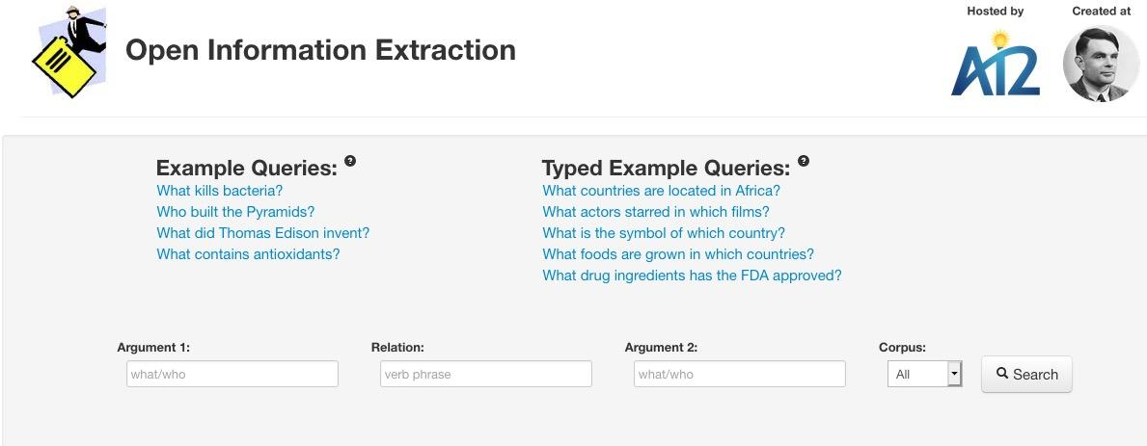
Unsupervised Relation Detection
Image and example from AllenAI
Notes:
Note types of “queries” that can be answered with simple Arg1 Rel Arg2 patterns

Slide 52
Next Week: Summarization

Slide 53
Event Detection and Template Filling

Slide 54
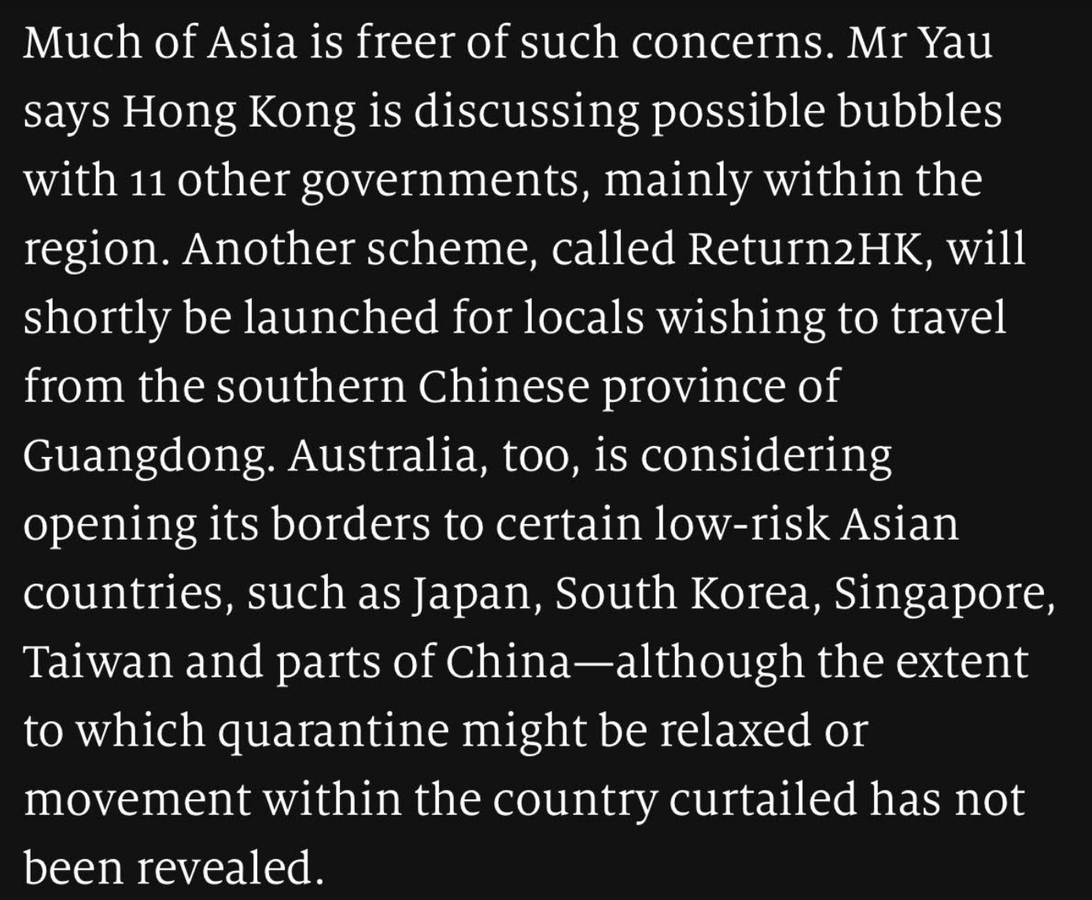
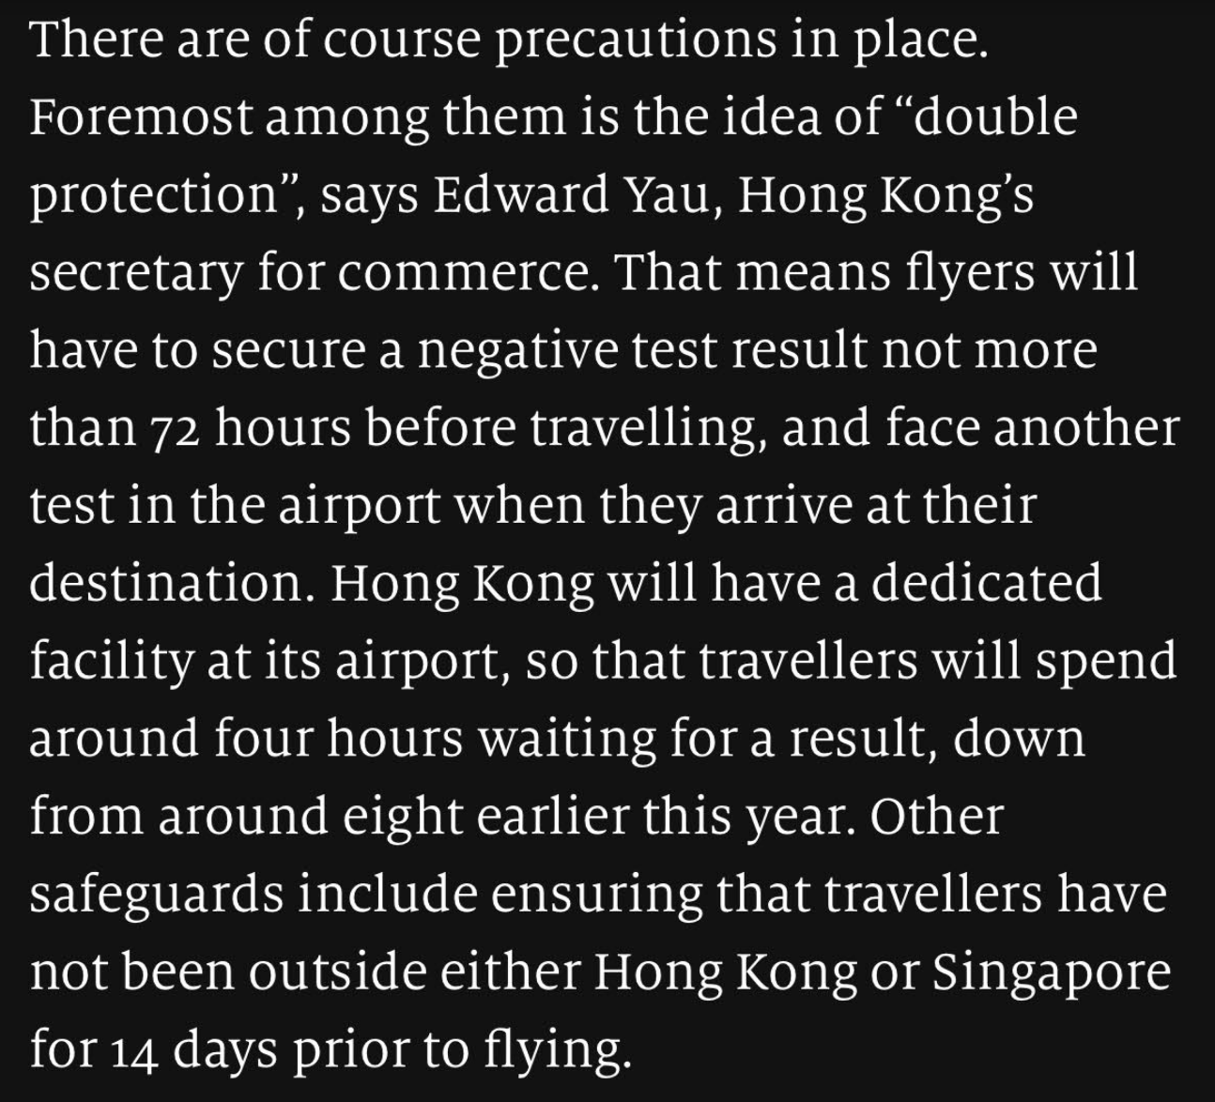
Information Extraction
Finally… text!
Say you are interested in Asia’s attitude towards Covid-19 policies… What may be good to Know?
...
From today’s Economist..
Notes:
We’ll cover information retrieval in week 12

